Slide 1
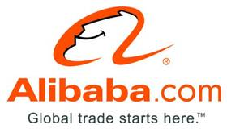
Alibaba.com: Global E-commerce
“ALIBABA.COM” an Asia Case Research Centre article from The University of Honk Kong

Slide 2
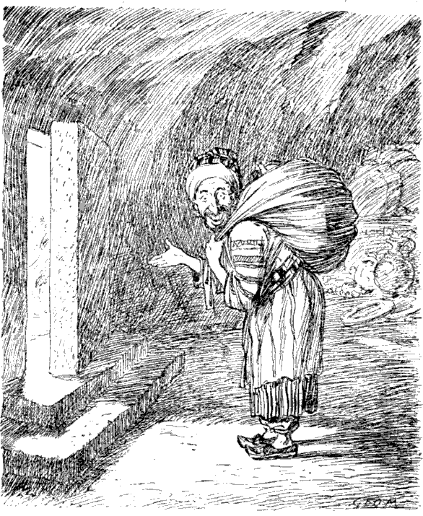
Open Sesame
B2B e-commerce: Platform for facilitating e-commerce between buyers and sellers
“The New Middle Man”
    Establishes a business presence online: standardized formats for profiles and catalogues
      “Storefronts”
      “Listings:
    Produces leads on potential trading partners
      30 Industry Categories
      5,000 product categories
      Keyword Searches
      Online Industry Directory
    Transaction Platform
      Community Features
        Interactive Communities
        TradeManager: IM
        Online Forums
      TrustPass
      Gold Supplier
      Alipay
    User Generated Content
Alibaba.com holds 50% of China’s online E-Commerce
market
Notes:
The name Alibaba comes from of course, the book called one thousand and one nights, which I’m sure you are all aware of. The name was chose because Alibaba knew the secret code “open sesame” which unlocked hidden treasures. This is the goal for alibaba.com → open sesame.
Alibaba.com is a business to business ecommerce website, much like eBay retail, but focusing on manufacturing and business services
Alibaba wants to be the new middle man. They do this by helping business establish their presence online through user friendly standardized formats for profiles and catalogues. They help businesses find potential trading partners. They also are a transaction platform. This means that their website is place to begin the process of buying and selling. For example, they have interactive communities, including an instant messaging program called Trade Manager, which allows you to talk to potential suppliers live time. As of 2007, Alibaba.com held 50% of China’s ecommerce B2B market.

Slide 3

To make it easy to do business anywhere.
*Multiple Languages: English, Korean, Simplified and Traditional Chinese
Risk Management
Advertising and Promotional Outlets and Services
Financing Plans
Ali-Advance: Pay for Performance keyword
bidding system
*AliExpress: a wholesale outlet
Ali-Institute: customer training and
e-commerce certification
*Highest Traffic Site for B2B Marketplaces
*Alisoft: business management software
Notes:
Alibaba.com’s mission statement is “to make it easy to do business anywhere”. They have all of these services and more facilitating business operations via an online platform.

Slide 4
1,000 and 1 Nights
1998: Jack Ma starts Alibaba Online
1999: 18 people, $60,000 → Alibaba Group
2000: SOFTBANK and Goldman Sachs become Joint Venture Bankers
2002: Break Even → Alibaba.com becomes Profitable
  Over 1 million registered users
2003: 1 million RMB profit daily ~ $150,000/day ($54,750,000/year)
2004: Alipay
2006: Restructuring for IPO
2007: 2nd Largest Internet IPO after Google, $1.7 billion
  Alibaba Group Valued at $25.6 billion
2010: Acquisition of Vendio (online auction aggregator); Acquisition of Auctivia (auction management)
Notes:
In just over ten years, they were able to grow from 18 employee, to over 10,000.

Slide 5
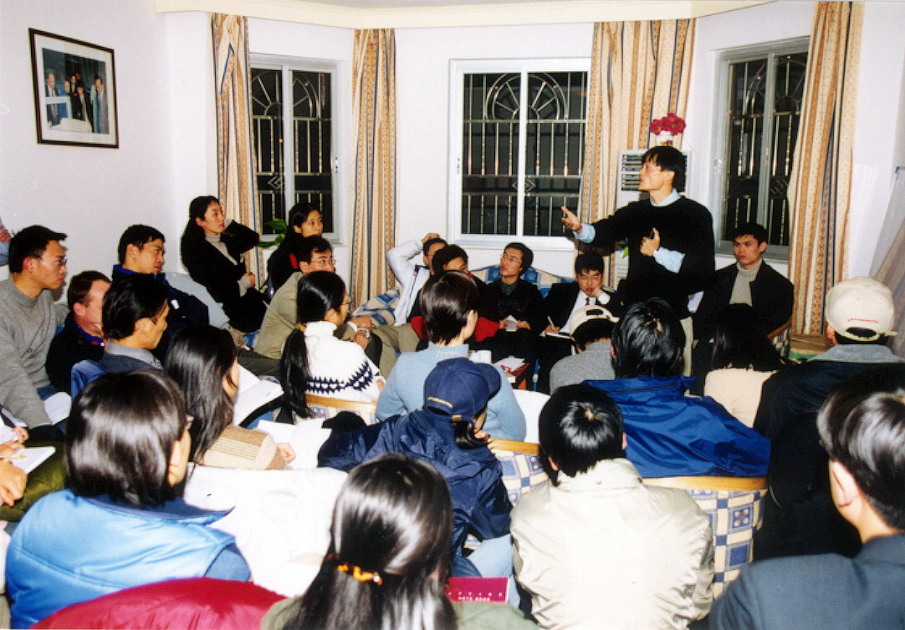

Slide 6
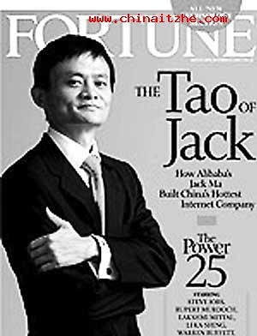
Mǎ Yún = Jack Ma
Visionary
Outward Looking
Charismatic
Involved
1995: no Chinese Beer on the Internet
  China Pages: China’s First Internet-Based Company
1998: Head of China International Electronic
Commerce Center
  Started Alibaba Online
Exit Strategy
“ Take matters into your own hands and take action in the form of starting businesses to cope with the economic downturn rather than waiting for government or business to help you” – Jack Ma, 2009, Annual Shareholders Meeting
“eBay may be a shark in the ocean, but I am a crocodile in the Yangtze River. If we fight in the ocean, we lose – but if we fight in the river, we win.” –Jack Ma, 2005
Notes:
Jack Ma has many of the characteristics an entrepreneur would have.
He is an involved CEO → he walks the floors of his company and check on employees and he is focused on creating a positive, energetic work force that is dynamic and socially charged. He is focused on environmental protection and theorizes that the purpose of business is to create a prosperous, harmonious society. Business should not be fouced on making money, but on helping others and building society.

Slide 7
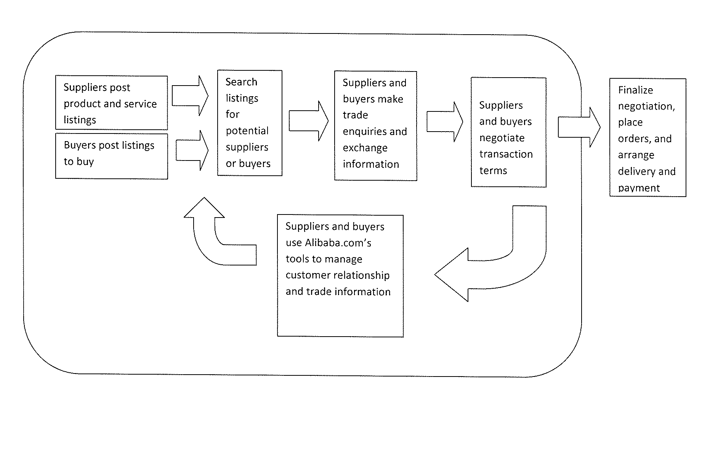

The Way It Works

Slide 8
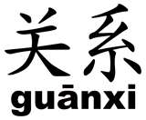
Major Challenge: Fragmentation
Difficulties in finding and communicating with trade partners
  Culture of Connections
Alibaba’s answer
  Online supplier and buyer directory
  Standardized and User friendly Storefronts and Listings
  Community Features
    TradeManager: IM
    200 Online Forums
    4.2 Million Registered Users by 2007
Notes:
To be listed on the directory is free, so they are driving people to their site based on number of listings.

Slide 9
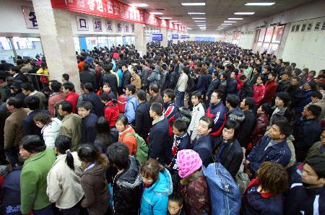
Major Challenge: Infrastructure
Geographic disconnect between suppliers and buyers
Low Internet Penetration: 12.3% online, 25.5% of users did e-shopping, 4.3% of business did online sales and marketing
Alibaba’s Answer:
  Internet breaks down
  geographic barriers
  3% annual Internet
  Penetration Growth Rate
  iResearch: 2007 Chinese
  online shopping market →
  $1.5 billion
  Chinese infrastructure building
  quickly

Slide 10

Major Challenge: Limited Communication and Information Channels
Difficulties finding
new markets and
suppliers
Alibaba’s Answer:
  Ali-Institute
  Tradeshows and Forums: online and offline
    Ali-Fest
  Network of Partners: Channel Sales Partners, Strategic Partnerships
Notes:
Ali Institute is a program put together to help with customer training and offers ecommerce certificates.
AliFest has over 5,000 business members attend annually.
Alibaba aggressively pursues strategic partnerships with chamber of commerce's, tradeshows, and marketing outlets

Slide 11

Major Challenge: SME’s Small Operations
Difficult for SME’s to find affordable marketing and promotional channels.
SME’s have limited resources for marketing and promotion
Alibaba’s Answer:
  Key Word Sales
  Premium listing in directory
  Flat Yearly subscription costs (no ad-hoc costs)
  Financing: companies with limited assets or credit history secure financing for expanding their business.

Slide 12

Major Challenge: Absence of a Credit Market
Difficulty in establishing trust with buyers and suppliers.
No widely used formal contract law within China
No credit rating agencies
Alibaba’s Answer:
  Gold Supplier
  Small Business Credit Ranking System
  Fair Play Fund
    http://news.alibaba.com/article/detail/safe-trading/100261595-1-fair-play-fund-fact-sheet.html
  China’s First Small Business Credit Rating System
Notes:
To qualify for a Gold Supplier membership, first you must have a premium membership subscription. Then you must undergo and pass authentication and verification procedures conducted by a reputable third-party
Fair Play Fund helps offset a portion of losses suffered by buyers defrauded by China Gold Supplier members.

Slide 13
THE VALUE PROPOSITION
SUPPLIERS
  Access
  Targeted marketing
  Customer service and training
  Always online
  Budget certainty
BUYERS
  Access
  Broad selection
  Access to high-quality, organized information
  Easy-to-use interface
  Convenient, real-time medium
  Authentication and trust profiles of suppliers

Slide 14


Competitors
  Global Sources: 21.2% of China’s Online Ecommerce Market
    Originally a Trade Magazine for suppliers and buyers within Asia
    2007: 647,000 buyers; 160,000 suppliers
    Online business = 40% of revenue
  HC360.com: domestic B2B e-commerce platform
  ChinaChemNet: vertical e-commerce
  E-Bay

Slide 15
Global Treasures: The Ecommerce Ecosystem
B2B: To Be an Essential Partner to All Businesspeople
  Alibaba China: http://china.alibaba.com/
  Alibaba International: http://www.alibaba.com/
  Ali-Express: http://www.aliexpress.com/
    Small Bulk Transactions
  Alibaba Japan: http://www.alibaba.co.jp/
  Alibaba UK: http://uk.alibaba.com/

Slide 16
More than B2B
Taobao: http://www.taobao.com/index_global.php
  “Searching for Treasure”
  C2C
  Largest Online Retail Platform
Alipay: https://www.alipay.com/
  Online Payment Platform
Yahoo! China: http://cn.yahoo.com/
  Search Engine
Koubei.com: http://www.koubei.com/
  Classified Listings Platform
Alimama.com: http://www.alimama.com/
  Advertising Exchange and Affiliate Network
Alibaba Cloud Computing
  Ecommerce Data Mining
  Ecommerce Data Processing

Slide 17

Global Vision, Local Win
“Start Up” Mentality
  Embracing Change
  “small, flexible, tailor made”
Developed Corporate Culture
Smelling Employees
Working to Help Others
Customer First | The interests of our community of users and paying members must be our first priority.
Team work | We expect our employees to collaborate as a team. We encourage input from our employees in the decision-making process, and expect every employee to commit to the team's objectives.
Embrace Change | We operate in a fast-evolving industry. We ask our employees to maintain flexibility, continue to innovate and adapt to new business conditions and practice.
Integrity | Integrity is at the heart of our business as trust is an essential element of a marketplace. We expect our employees to uphold the highest standards of integrity and to deliver on their commitments.
Passion | Our employees are encouraged to act with passion whether it is serving customers or developing new services and products.
Commitment | Our employees have a dedicated focus and commitment to understanding and delivering on the needs of Chinese and global SMEs.
Notes:
Jack Ma wants his employees to have a mentality that their business is a start up, no matter how big. Once employees believe everything is up and running, this creates a kind of laziness. Ma wants a sort of revolutionary business, where barriers and standards are broken down and rebuilt better, almost systematically.
Alibaba has a strong corporate culture with values such as placing the customer first, employees second, and then profits third. They value integrity passion and commitment.
Ma is known for walking the floor and “sniffing” his employees. In this way he can get a sense if everyone is happy. He expects his managers to be sniffing their employees as well. A happy work place is a successful work place.
Alibaba was built around the idea that business is for making society better. Ma says that employees should be working, not for themselves, but for their coworkers.

Slide 18
Revenue
Historically Free Basic Services: Attracting Hits
Slow increase in required registration fees and increased fee based value-added services: Sales Revenue
  $5,373.60/year for Standard Package
  $8,060.40/year for Premium Package
Engaging Leads: Advertising Revenue
  Purchasing Key Words
  Priority Placement
70% of revenue from International Market Place
71% of revenue from Gold Supplier Members

Slide 19
Today
17,000 Employees in more than 50
Cities
50 Million Users
240 Countries

Slide 20
References
Barnett, W. (2010). TAOBAO VS. EBAY CHINA. Stanford: Stanford Graduate School of Business.
Erisman, P. (2008). Alibaba.com: The Gateway to Global Trade for SMEs in South Korea. Alibaba Group.
Fannin, R. (2008). HOW I DID IT JACK MA ALIBABA.COM INC, 30(1), 104-106. Retrieved October 20, 2010, from Business Source Premier database: http://summit.csuci.edu:2321/ehost/detail?vid=3&hid=106&sid=c9435d80-d6d0-4079-b7ca-96c91fc2b9ca%40sessionmgr112&bdata=JnNpdGU9ZWhvc3QtbGl2ZQ%3d%3d#db=buh&AN=28532333
Farhoomand, A. (2008). Alibaba.com. Hong Kong: The Asia Case Research Centre, the University of Hong Kong.
Group, A. (2001). Alibaba.com. Retrieved October 22, 2010, from http://www.alibaba.com/
Unknown. (n.d.). Alibaba.com: A Smiling Community with a Dream. Retrieved October 2010, from Unknown: http://media.ft.com/cms/c6aba388-74a6-11db-bc76-0000779e2340.pdf
Wikimedia Foundation, Inc. (2010, October 20). Alibaba.com. Retrieved October 20, 2010, from Wikipedia: http://en.wikipedia.org/wiki/Alibaba.com
Wikimedia Foundation, Inc. (2010, October 20). Jack Ma. Retrieved October 20, 2010, from Wikipedia: http://en.wikipedia.org/wiki/Jack_Ma

Slide 21
Questions
Which of the following was NOT a major challenge for Alibaba Group?
  A. Under Developed Infrastructure
  B. Lack of Commonly Used Contract Law
  C. Chinese dislike for Foreign Business Opportunities
  D. Lack of an established Credit System
How does Alibaba Group create revenue?
  A. Commissions on Sale Leads
  B. Annual Subscription Fees
  C. Trader Directory Listing Fee
What did iResearch value at $1.5 billion?
  A. Chinese Silk Market
  B. Chinese Opium Market
  C. Chinese Online Shopping Market
  D. Chinese Tourism Market
How does Alibaba Group create a trust and rating system for its online users?
  A. Gold Supplier
  B. Ali-Express
  C. Alimama.com
  D. Yahoo! China

Slide 22


